Slide 1

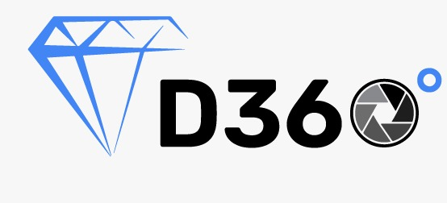


Sponsor : D360 Technologies
Track name : Track-2
Title : D360
Team Name: Phoenix
Team Members: Om Patel
Bhavdip Patel
Dhruvil Prajapati
Viraj Patel
Tarjni Patel

Slide 2
Problem Statement
Create a conversational AI model using Google Dialogflow that can understand natural language queries for diamonds and generate filtering parameters for a large inventory of diamond data.
Example :
User Input: I am looking for vvs diamond of g to i color of size around 1 carat
Output: Dialogflow should generate the following filter:
Columns = [(all columns)]
Weight = [0.85 - 1.15]
Color = [g, h, i]
Clarity = [vvs]

Slide 3
Introduction
Diamond industry has very big market and that why it has so many data which can now access using the computer
In this case it is very difficult to get information about particular diamond using human understandable language.
here we Use NLP and Dilogflow to get important information from human input and output all important information which can be further use to filter the diamond using that parameter

Slide 4
Proposed approach
First We Study the all parameter of diamond which also know as 4c properties of diamond
After that we crate agent D360 in Dialogflow Framwork
In 360 we can crate Intents for different different queries
After that We crate custom Entities For different parameter of diamond like shape, colour,cut,weight etc
After we make output response which is use for filter

Slide 5
Why should one choose your solution
First We Study the all parameter of diamond which also know as 4c properties of diamond
After that we crate agent D360 in Dialogflow Framwork
In 360 we can crate Intents for different different queries
After that We crate custom Entities For different parameter of diamond like shape, colour,cut,weight etc
After we make output response which is use for filter

Slide 6
Limitation of our solution:
In complex input we need add more intents
We also use good quilts of regexp in entities

Slide 7
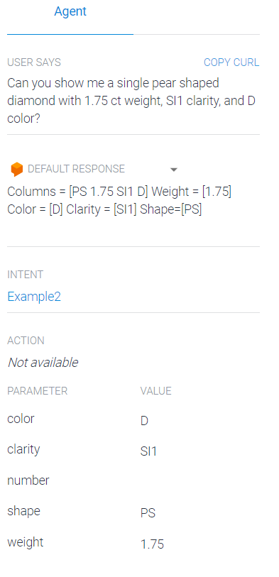
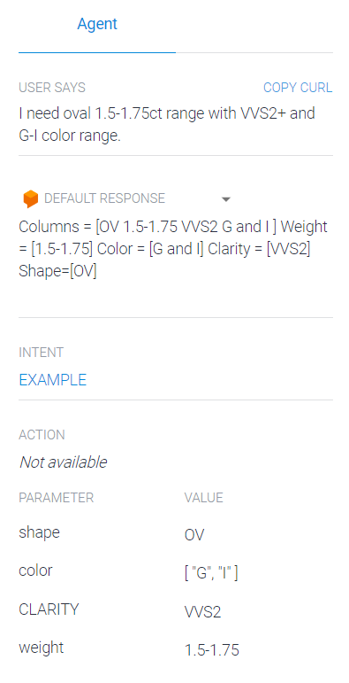
Demonstration of our solution
Example :

Slide 8
References:
https://diamondbuzz.blog/diamond-properties-and-characteristics/
https://cloud.google.com/dialogflow/docs

